Slide 1

CSE3BDC/CSE5BDC
Big Data Management on the Cloud
Lecturer: Zhen He
Lecture 8

Slide 2
SparkSQL

Slide 3
Outline of Lecture
What is SparkSQL?
Why SparkSQL?
  Structured versus Unstructured data
  Easier to program
    SQL syntax
    Can refer to data via column names
    Data source API
  Faster
    Query optimization
    Project Tungsten
      CPU optimization
      Fit more data in memory
      Custom code generation
    Column storage format
How to program SparkSQL

Slide 4
What is SparkSQL?
Spark SQL is Apache Spark's module for working with structured data.
Spark
Streaming
SparkSQL
GraphX
MLlib
Spark

Slide 5
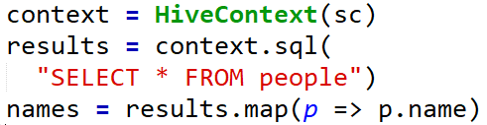
Seamlessly mix SQL queries with Spark Programs
Spark SQL lets you query structured data inside Spark programs, using either SQL or a familiar DataFrame API. Usable in Java, Scala, Python and R.
The above shows applying a function to the results of SQL queries

Slide 6
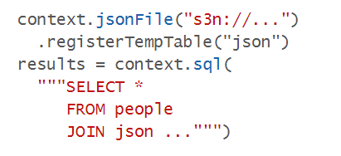
Uniform Data Access
Connect to any data source the same way.
DataFrames and SQL provide a common way to access a variety of data sources, including Hive, Avro, Parquet, ORC, JSON, and JDBC. You can even join data across these sources.
Query and join different data sources

Slide 7
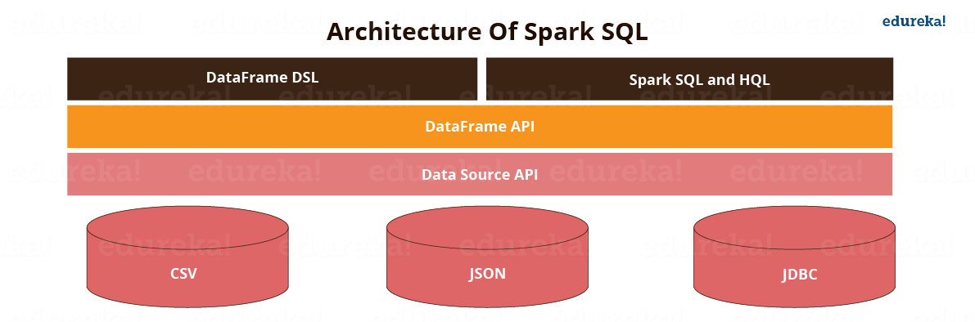
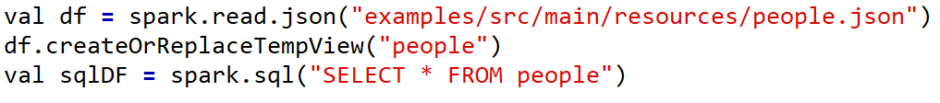
The Data Source API allows SparkSQL to read and write to data in a wide variety of data formats.
People can query database via the DataFrames API using either DataFrame DSL (domain-specific language) or Spark SQL and HQL
DataFrame DSL example
Spark SQL syntax

Slide 8
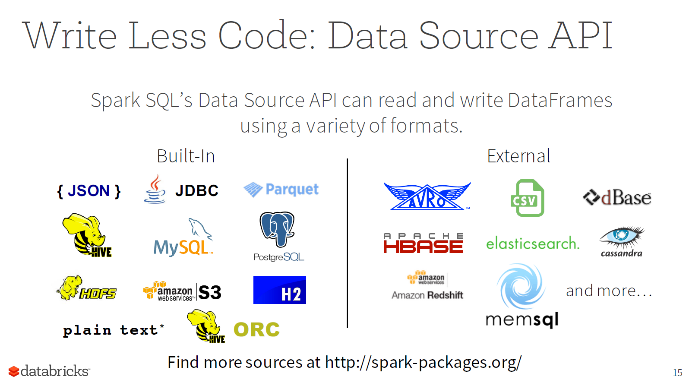

Slide 9
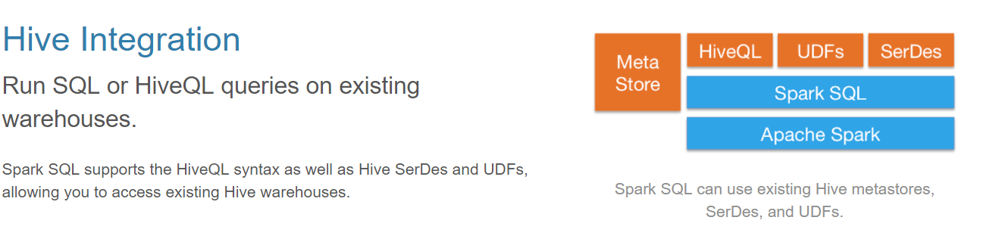

Slide 10
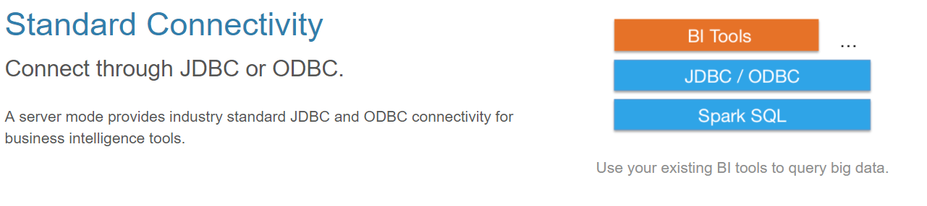

Slide 11


What is wrong with just using RDDs?
When you write code like this
The lambda function (computation) is opaque to spark, so it can not do any optimization.
The filter function is designed to take any predicate lambda function.

Slide 12
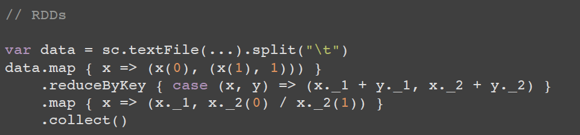
Structured versus Unstructured Code
Unstructured code (computes an average per group)
    Hard to read
    What information is in x(0), x(1)?
    Spark can not optimize the code since lambda functions used are opaque to it
Structured code (also computes average per group)
  Easier to read, the columns are given proper names instead of x(0), x(1)
  Spark can optimize this code since it uses Sparks SQL functions.
Slide credit: http://scala-phase.org/talks/rdds-dataframes-datasets-2016-06-16/#/9

Slide 13
DataFrames
DataFrames lets you write nice structured code like this:
However, it does not provide type safety
  For example if the column “name” does not exist you will not know this until there is an error at run time.
  So your code may have already done a lot of work and then it suddenly crashes since it finds that the column you are trying to use does not exist
Slide credit: http://scala-phase.org/talks/rdds-dataframes-datasets-2016-06-16/#/9

Slide 14
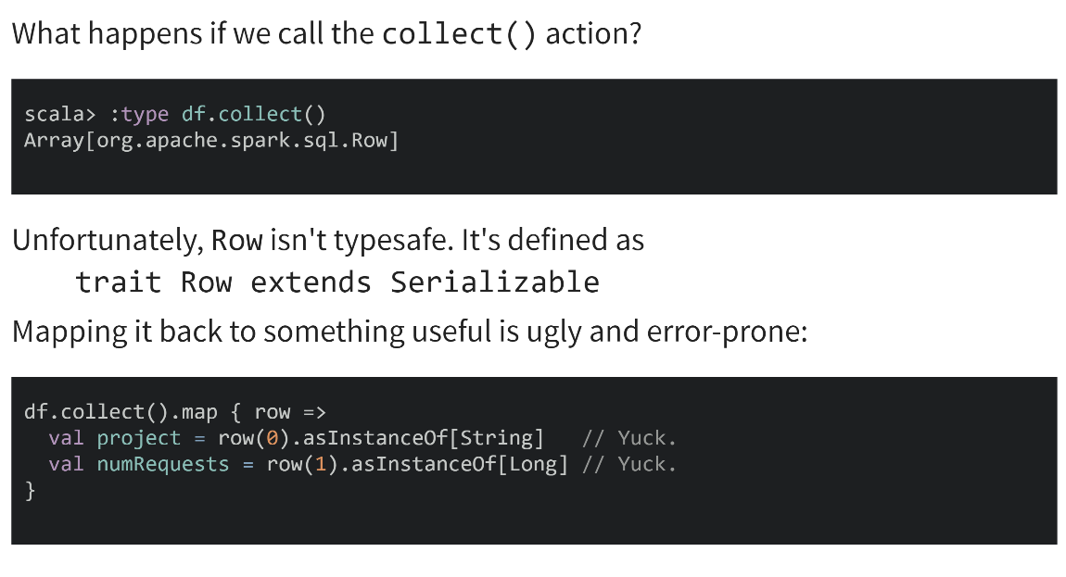
Data Frames do no have type safety
Slide credit: http://scala-phase.org/talks/rdds-dataframes-datasets-2016-06-16/#/9

Slide 15
Datasets
Conceptually similar to RDDs. (You can use lambdas and types again.)
Use Tungsten's fast in-memory encoding (as opposed to JVM objects or serialized objects on the heap)
Expose expressions and fields to the DataFrame query planner, where the optimizer can use them to make decisions. (This can't happen with RDDs.)
Slide credit: http://scala-phase.org/talks/rdds-dataframes-datasets-2016-06-16/#/9

Slide 16
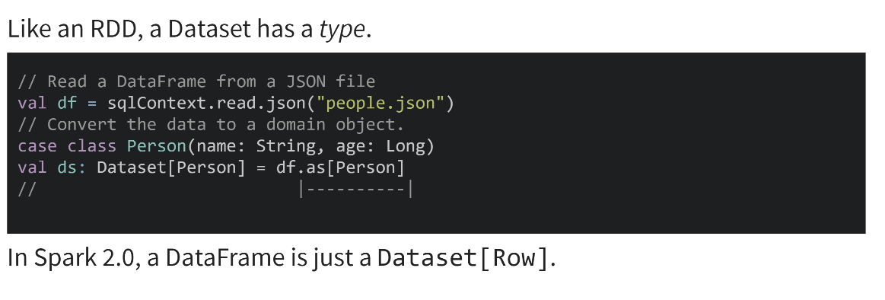
Datasets
In the above code the DataFrame is converted to a Dataset by specifying the type using the as function. In this case the type is the case class Person.

Slide 17
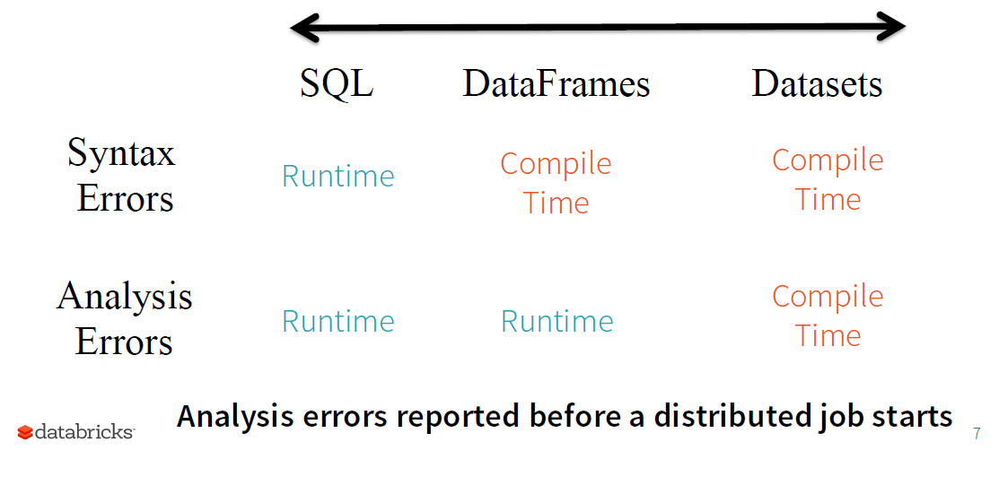
Why use structured code? (Can find errors earlier)
e.g. spelt SELECT wrong
e.g. column does not exist

Slide 18
DataFrame = Dataset[Row]
DataFrames are just Dataset of Rows in Scala and Java API
Spark 2.0 unifies DataFrame and Dataset APIs
DataFrames are just Dataset of Rows in Scala and Java API.
  Can not check analysis errors at compile time
  These operations are also referred as “untyped transformations” in contrast to “typed transformations”
Ask Spark SQL to enforce types on generic rows using df.as[MyClass]
  Can check analysis errors at compile time
  Typed transformations

Slide 19
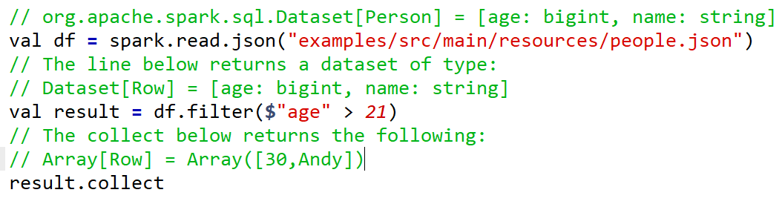
Typed versus Untyped transformations
Here are example untyped transformations using dataframes
Notice in the above code the output from the collect action is an array of Rows. The columns in each row are not named and hence you would need get them via row(0) for age and row(1) for name

Slide 20
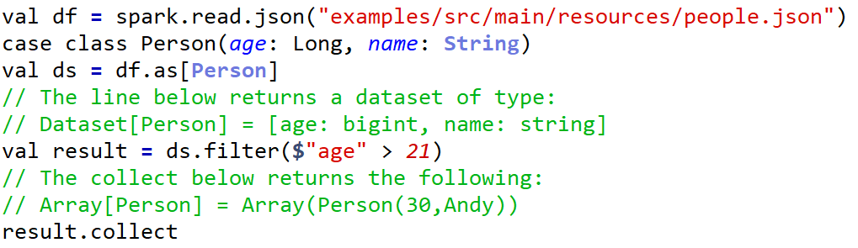
Typed versus Untyped transformations
Here is the same example using typed transformations on a dataset which has the Type Person specified
Notice in this case the collected array has elements with type Person. This is much nicer since you can use person.age and person.name to extract the age and name columns.

Slide 21
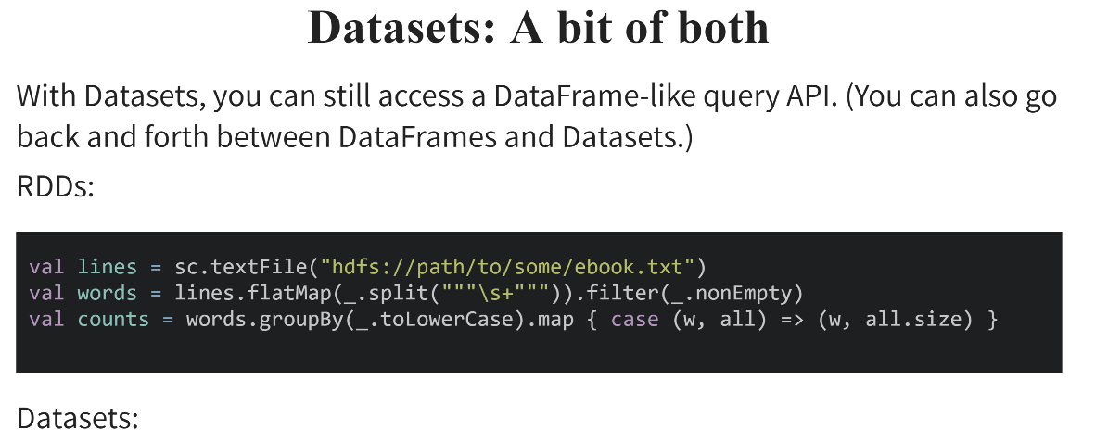

Slide credit: http://scala-phase.org/talks/rdds-dataframes-datasets-2016-06-16/#/9

Slide 22
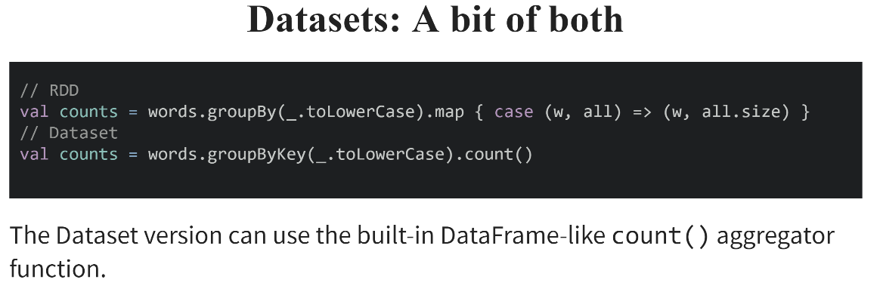
Slide credit: http://scala-phase.org/talks/rdds-dataframes-datasets-2016-06-16/#/9

Slide 23
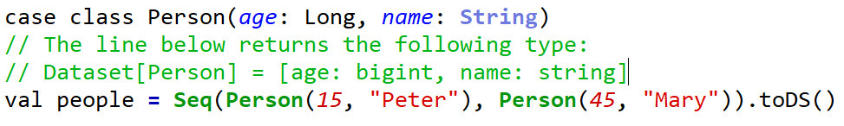
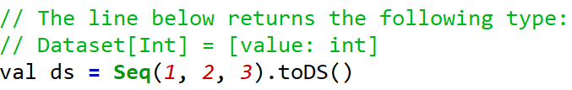
Another way to create a data set
The toDS() can be used to create a data set.

Slide 24
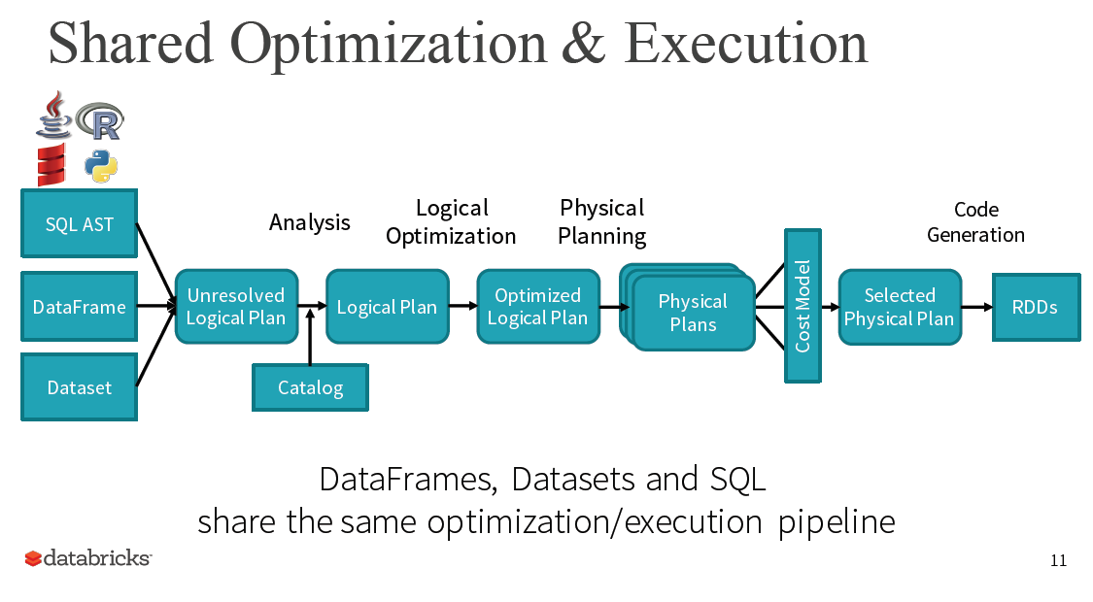
Note at the end the generated code uses the RDD API.
udfs
One of the major benefits of using structured data is that you can do optimization on it.

Slide 25
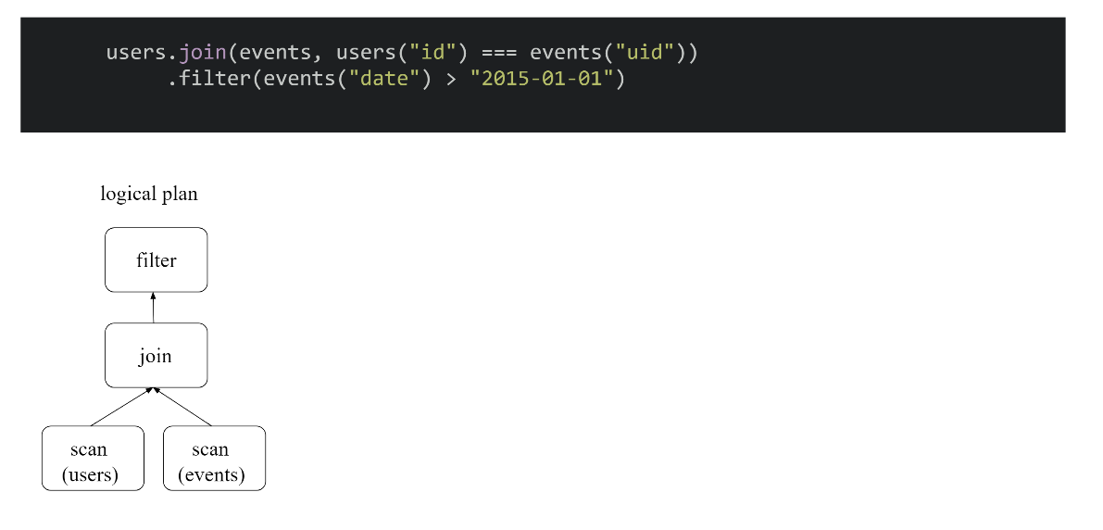
Why use a query optimizer?
This code above is very sub-optimal, since it does the join before doing the filter.
It is much better if we first do the filter and then do the join. Since the filter would first make the data much smaller. This means there will be less data shuffled across the network. Since doing the join requires shuffling the data.
Join is not efficient
Slide credit: http://scala-phase.org/talks/rdds-dataframes-datasets-2016-06-16/#/9

Slide 26
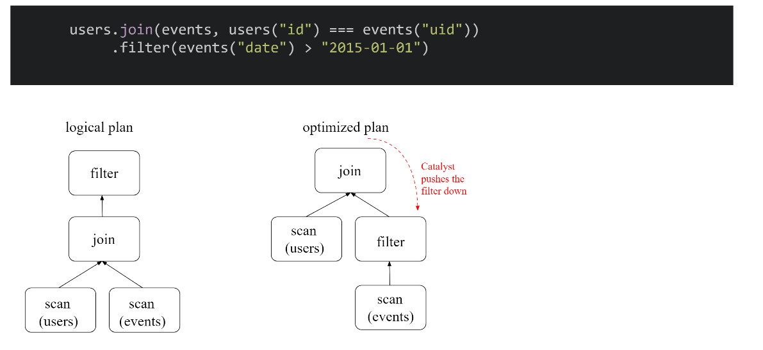
Why use a query optimizer?
The catalyst query optimizer creates an optimized plan which pushes the filter operation down the query tree.
Slide credit: http://scala-phase.org/talks/rdds-dataframes-datasets-2016-06-16/#/9

Slide 27
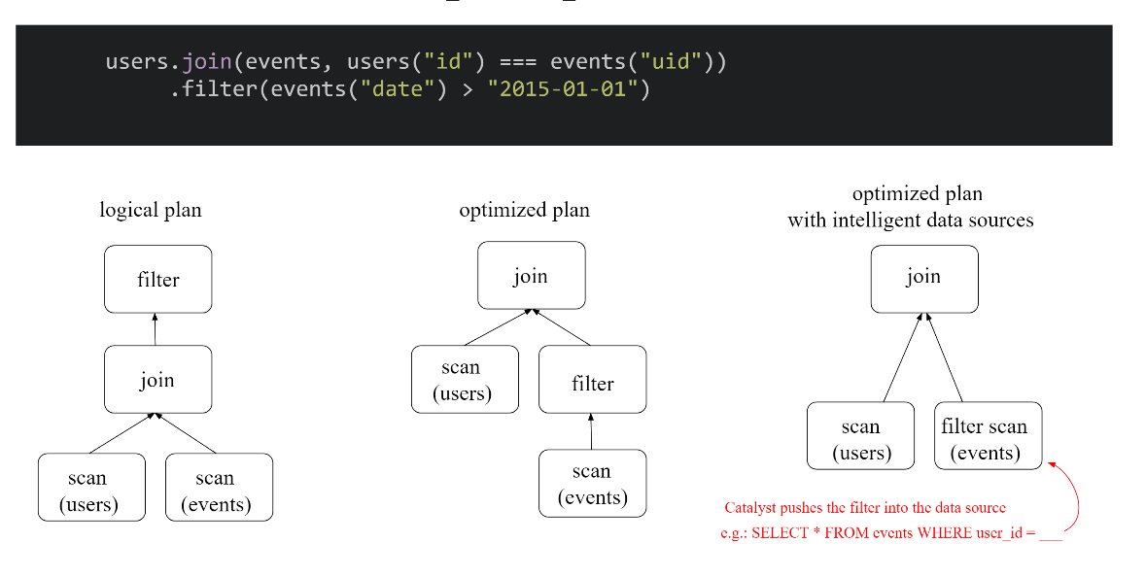
Why use a query optimizer?
Slide credit: http://scala-phase.org/talks/rdds-dataframes-datasets-2016-06-16/#/9

Slide 28
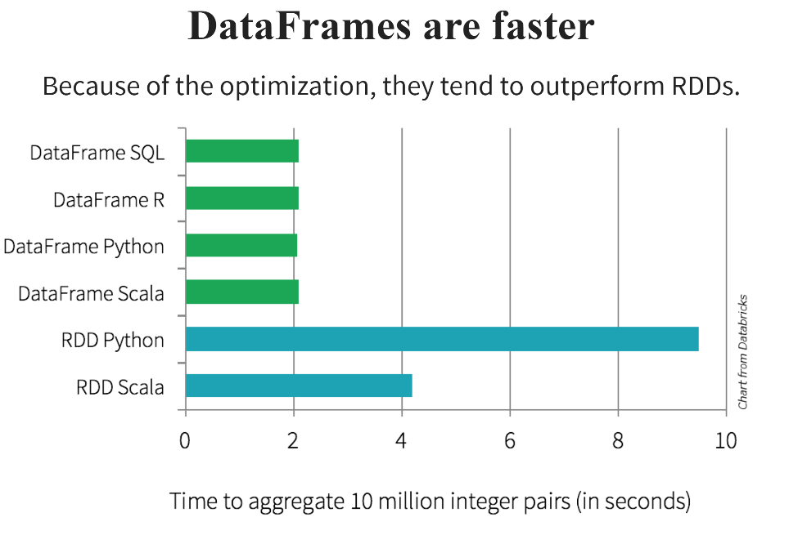

Slide 29
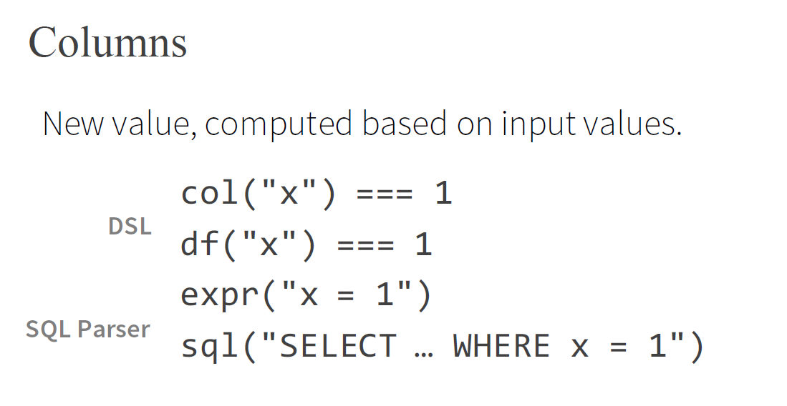
All of these translate to the same spark code
Can use expr(…) to write any SQL expression

Slide 30
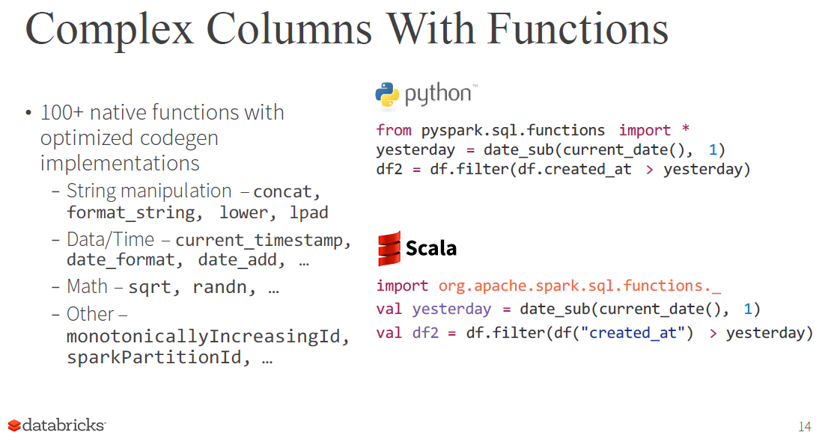
All the above functions can be used to generate highly optimized code at runtime by the optimizer
You can write a lot of different types of programs using the above functions. It offers a lot of flexibility.
If you use the above functions the python code is the same speed as the scala code.

Slide 31
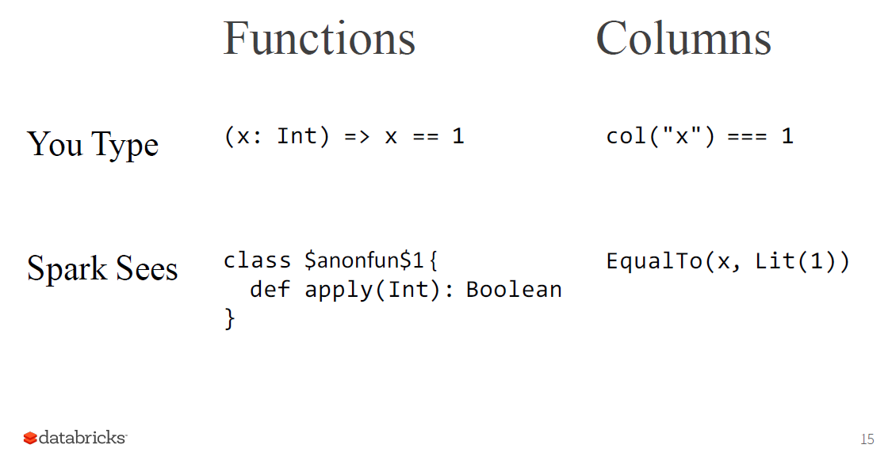
Scala lambda function
There is no optimization that can be done since spark just sees this function prototype
Spark can optimize this since it uses a spark function

Slide 32
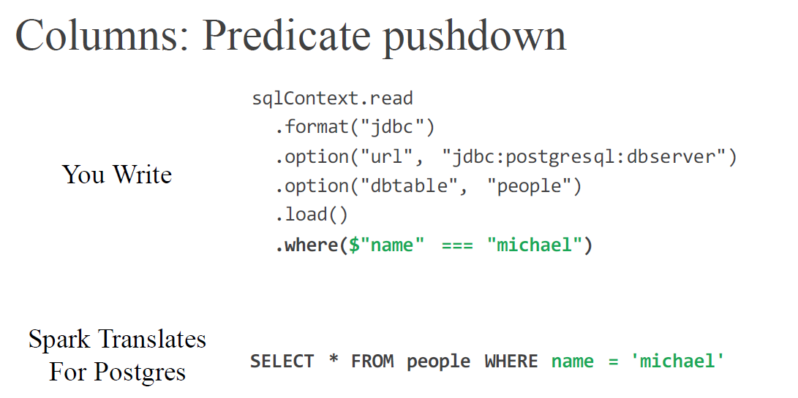
In the above example by using the .where clause in the code, we can get the postgres database to execute the where clause for use inside itself
  This is much faster than if we had to do a filter operation in spark.

Slide 33
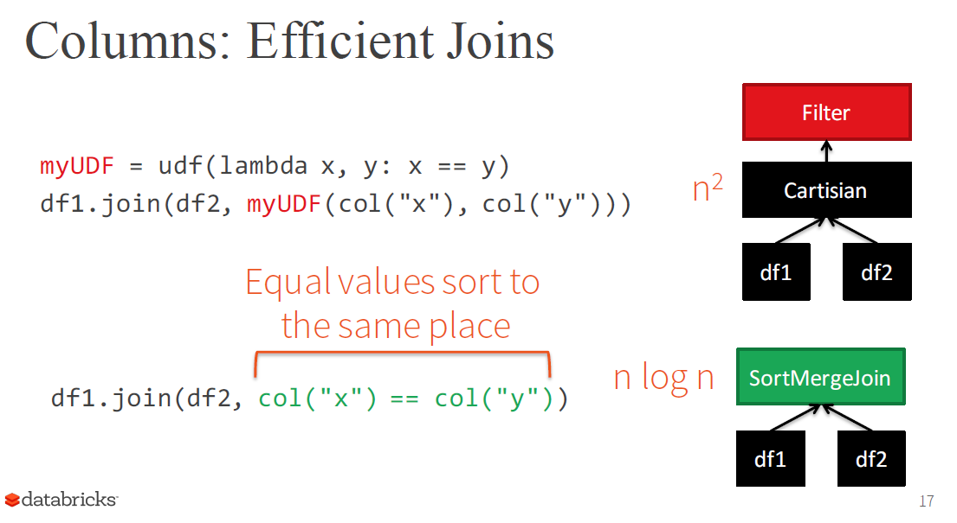
Spark can not optimize this since we wrote the logic in an udf, hence it needs to do a Cartesian product.
This code is much more optimized since we are using only spark functions. Hence spark can do much more efficient merge join

Slide 34
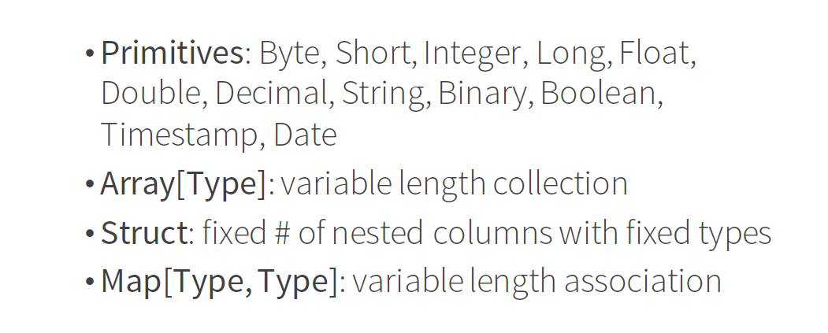
Spark’s own internal structure representation
case class Body(id: Int, width: Double, height: Double, depth: Double, material: String, color: String)
Spark maps data from any format into its own encoding.
  E.g. case class Subject(id: Int, names: Array[String]) is mapped format as described below

Slide 35
Tungsten’s Compact Encoding
The aim of project tungsten is to optimize CPU and memory usage.
This only works with Dataframes and Datasets.
Spark understands the structure of data because they're typed
Spark uses encoders to translate between these types ("domain objects") and Spark's compact internal Tungsten data format.
The encoder actually generates code that does the conversion.
  The conversion code is highly optimized and therefore can convert the data much faster than Java’s standard serializers
  Generates custom byte code that is highly optimized for your particular situation.
Data in the internal format is highly optimized so it does compression and uses less memory

Slide 36
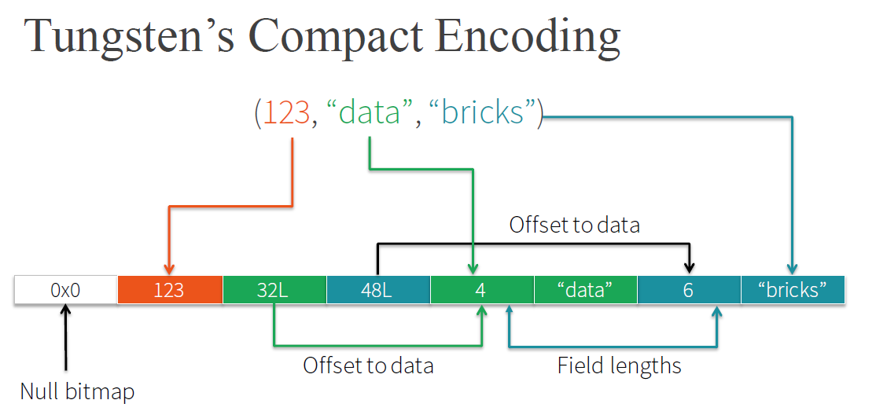
Takes structured data and produces a highly efficient encoded blob of bytes
  This blob of bytes uses much less bytes of memory
  Less data to shuffle across the network

Slide 37
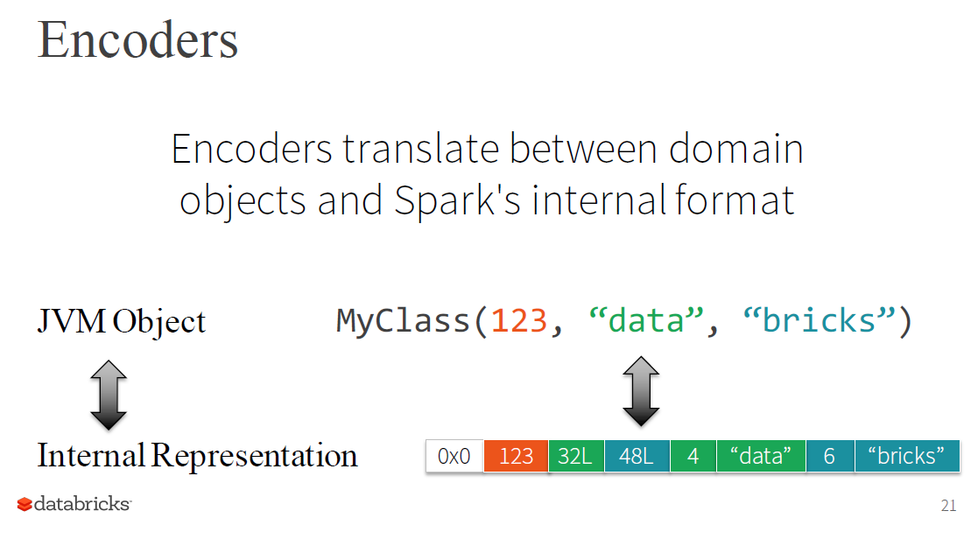

Slide 38
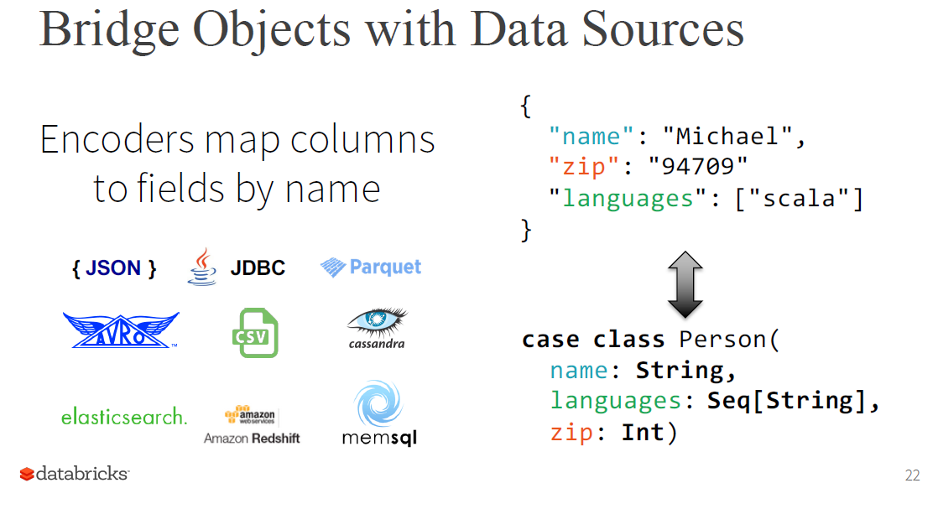

Slide 39
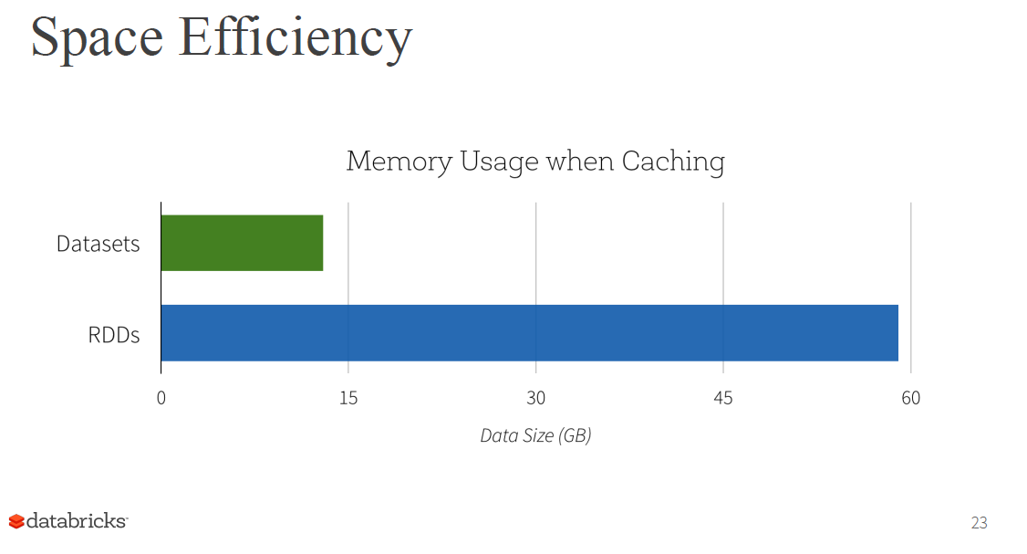

Slide 40
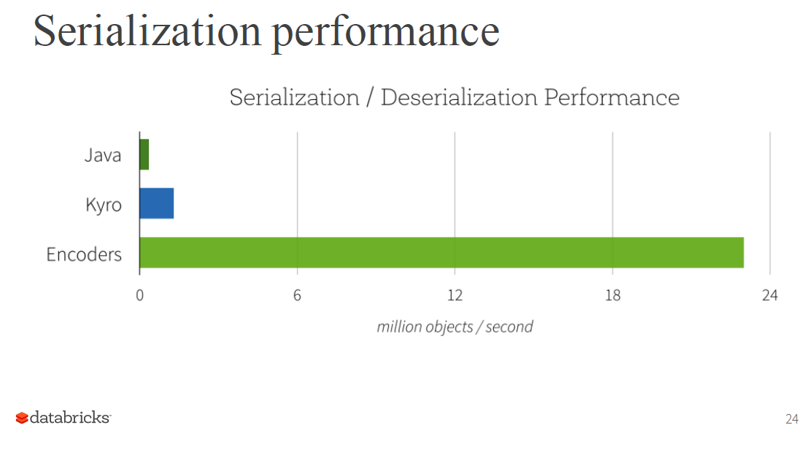

Slide 41
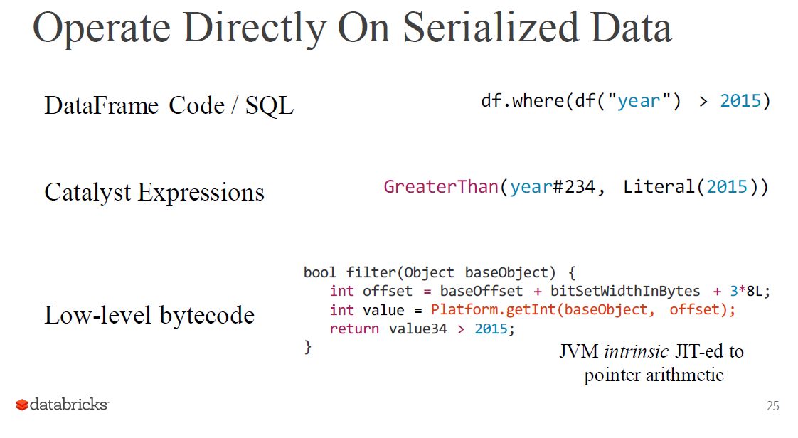
(optimizer)
Custom code generated for this example
No object creation or garbage collection
The generated code runs only 10% to 15% slower than optimized C++ code!!

Slide 42
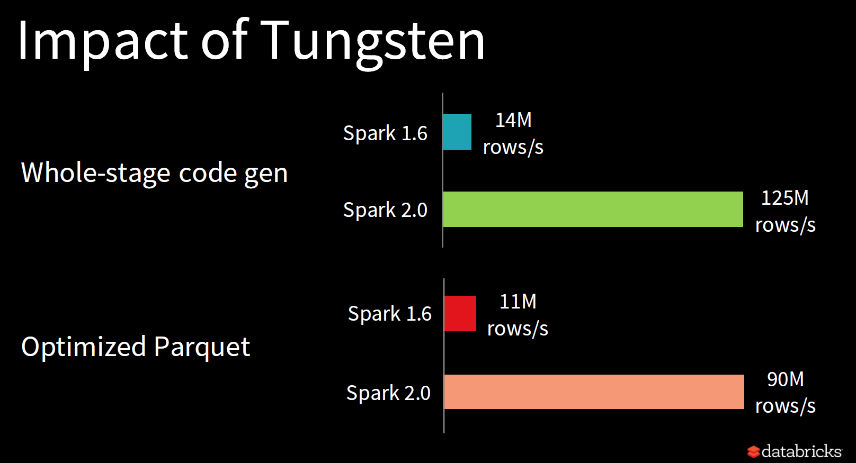
As you can see above the CPU optimization via Tungsten has a very large impact on performance.
The Parquet performance relates to the performance when converting data into the compact column oriented storage format.

Slide 43
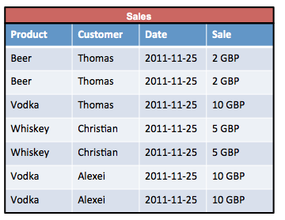
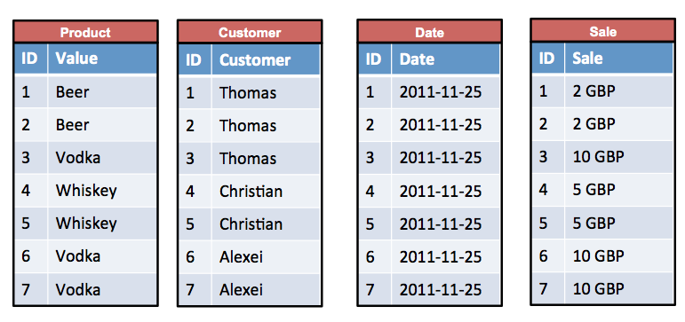
Efficient Storage: Parquet Format
Row format
Column format
Diagram source: http://kejser.org/how-do-column-stores-work/
Spark SQL allows data to be stored in column format.
Each column is stored in a different partition.

Slide 44
Why column format?
Row format
Column format
Diagram source: http://kejser.org/how-do-column-stores-work/
A lot less data need to be loaded
  Many companies have tables with many columns (e.g. 100s of columns).
  Storing the data in row format would mean you need to load all the data even if you only want data from two columns.
  Using column format you only need to load the columns that you query.
For example if we want all the records for the customer and sale columns in row format you would need to load all the data. But if the data is in column format you only need to load the customer or sale columns.

Slide 45
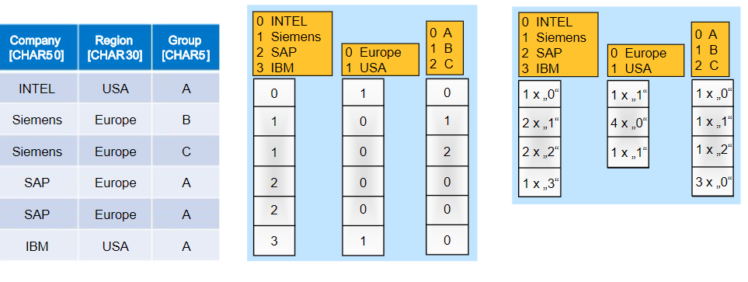
Why Column Format?
Original data
Dictionary encoded data
Run length encoded data
Storing data column wise allows you to better compress the data.
  In the labs you will see that data stored in Parquet format is very small
For example in the example above we can use run-length encoding of the data in each column to reduce the size of each column.

Slide 46
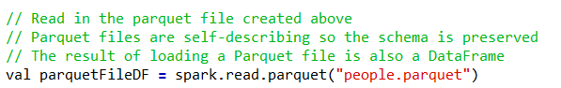


Parquet Format
  The above example shows how to load data that is stored in parquet format into a dataframe. Note no schema needs to be specified since it is already stored in the parquet file.
  The above shows how to load a parquet file into a dataset.
  When you save the data in parquet format it also saves the schema in the parquet file

Slide 47
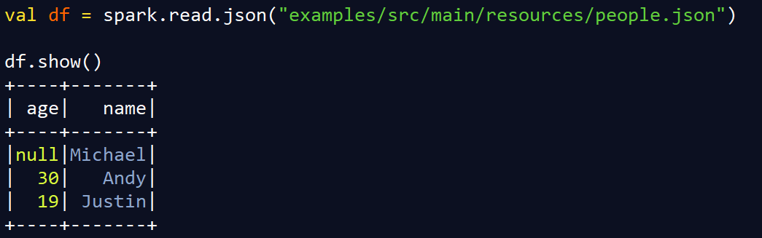
Creating Data Frames
Assume the people.json has the following information:
      {"name":"Michael"}
      {"name":"Andy", "age":30}
      {"name":"Justin", "age":19}
The code above reads a json into a dataframe. Spark is able to automatically infer the schema of the json by sampling the data.
The show function is use to display the contents of the dataframe.

Slide 48
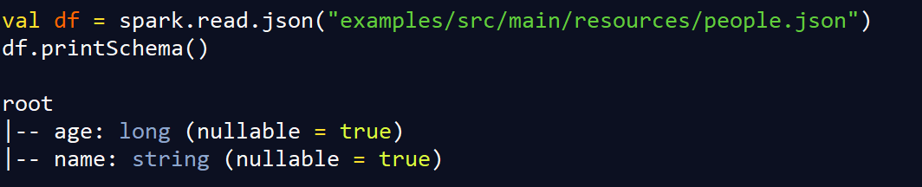
Print Schema
Assume the people.json has the following information:
      {"name":"Michael"}
      {"name":"Andy", "age":30}
      {"name":"Justin", "age":19}
The code above prints out the schema that spark has inferred for the json file.

Slide 49
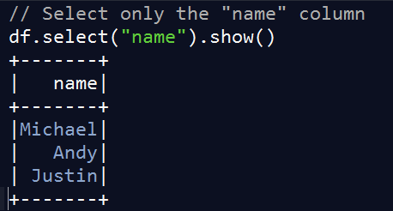
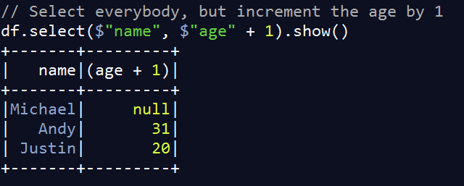
Select
Assume the people.json has the following information:
      {"name":"Michael"}
      {"name":"Andy", "age":30}
      {"name":"Justin", "age":19}

Slide 50
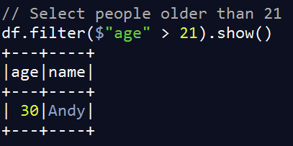
Filter
Assume the people.json has the following information:
      {"name":"Michael"}
      {"name":"Andy", "age":30}
      {"name":"Justin", "age":19}

Slide 51
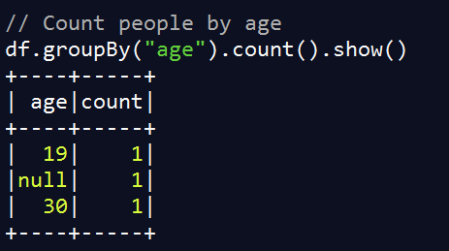
groupBy
Assume the people.json has the following information:
      {"name":"Michael"}
      {"name":"Andy", "age":30}
      {"name":"Justin", "age":19}

Slide 52
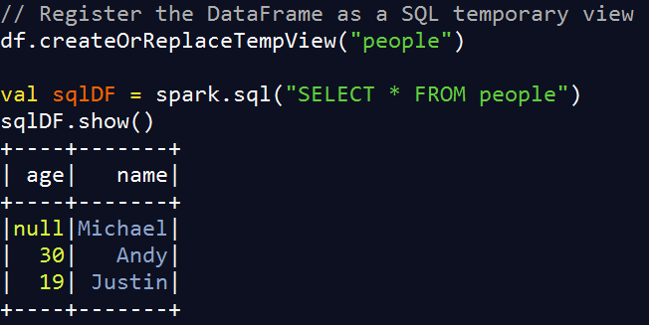
Running SQL Queries Programmatically
Assume the people.json has the following information:
      {"name":"Michael"}
      {"name":"Andy", "age":30}
      {"name":"Justin", "age":19}

Slide 53
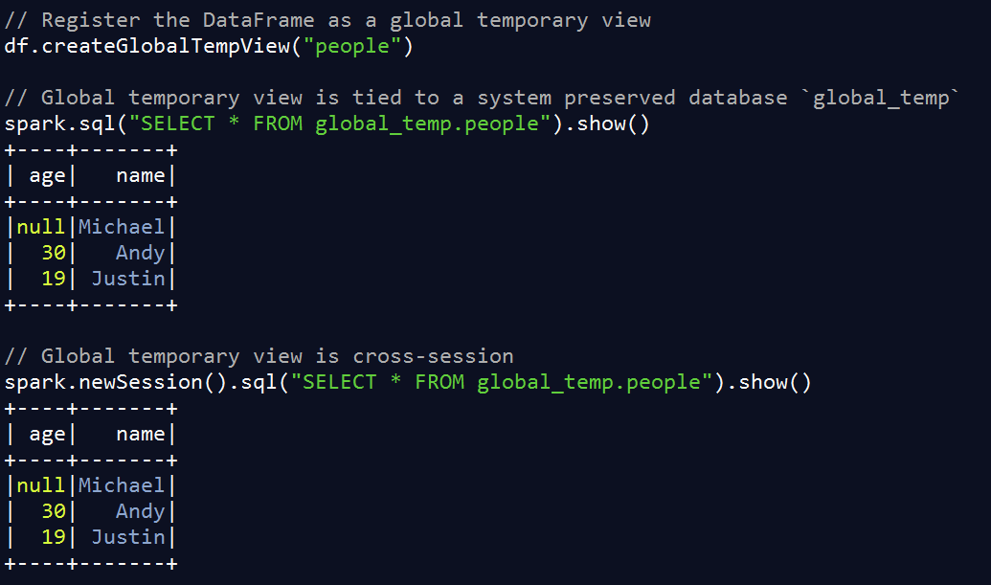
Global Temporary View
Temporary views such as that shown in the previous slide will only exist during the session.
Global temporal views can be used to keep dataframes across sessions.
  Like in Hive, when you end a session, the table still stays in the database.

Slide 54
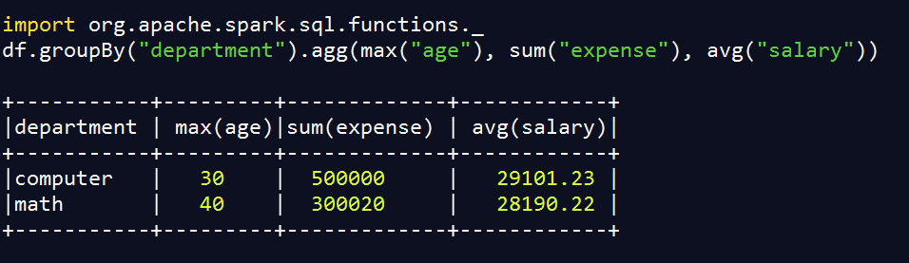
Aggregation
Inside the RelationalGroupedDataset class there is a function method called agg that can be used to return different types of aggregations.
The above example shows how to compute multiple types of aggregation for each group.
  In the above case, we first group by “department”. For each department we compute the maximum age, the total expenses and the average salary.
For more API calls for the RelationalGroupedDataset class see the link below:
  https://spark.apache.org/docs/2.0.1/api/java/org/apache/spark/sql/RelationalGroupedDataset.html

Slide 55
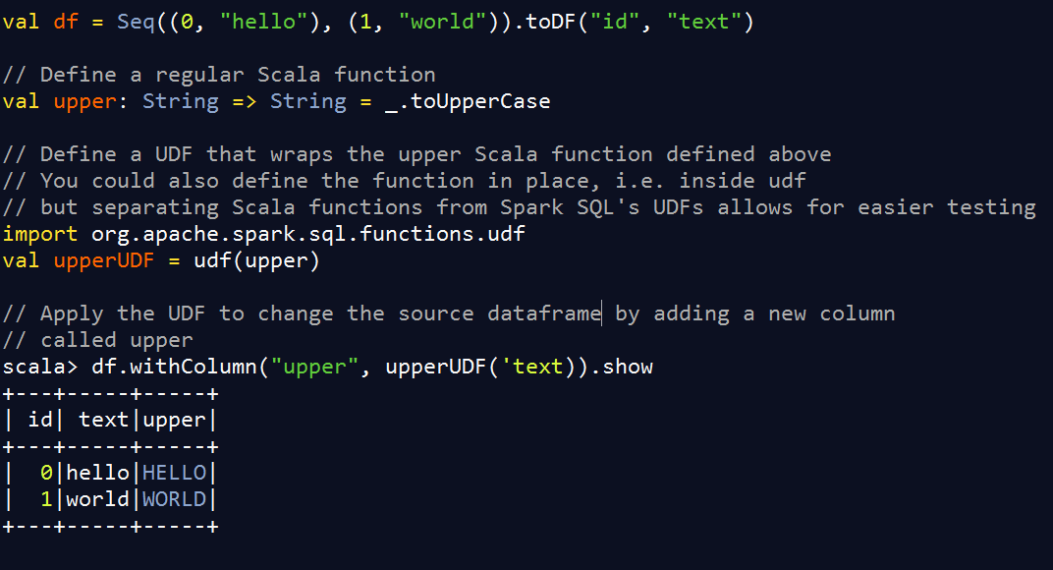
User Defined Functions and Adding new Columns
Often when you write code you want to call a customized function.
In the example below we want to add a new column which has the text in upper case

Slide 56
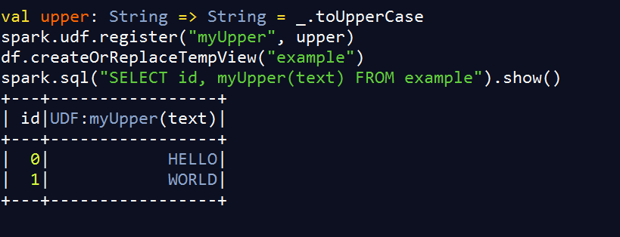
UDF Registration
You can register UDFs to use in SQL-based query expressions via UDFRegistration

Slide 57

Horizontal partitioning of data
Australia Folder
Peter | Australia | M
Name | Country | Gender
Peter | Australia | M
Alice | USA | F
Ashley | Australia | M
Pauline | Spain | F
George | Australia | M
Matei | Spain | M
Ashley | Australia | M
George | Australia | M
USA Folder
Alice | USA | F
Spain folder
Pauline | Spain | F
Matei | Spain | M

Slide 58
Horizontal partitioning of data
Directory structure
/byCountry.parquet/country=Australia
/byCountry.parquet/country=USA
/byCountry.parquet/country=Spain
We can partition by country as follows:
  val df = spark.read.json("example_people.json")
  df.write.mode("overwrite").partitionBy("country").format("parquet").save("byCountry.parquet")
The code below just shows the rows of the table that contain USA people which confines the query to just the directory /byCountry.parquet/country=USA.
  val partitioned_df = spark.read.parquet("byCountry.parquet")
  partitioned_df.filter($Country==“USA”).show()
Name | Country | Gender
Peter | Australia | M
Alice | USA | F
Ashley | Australia | M
Pauline | Spain | F
George | Australia | M
Matei | Spain | M
Peter | Australia | M
Ashley | Australia | M
George | Australia | M
Alice | USA | F
Pauline | Spain | F
Matei | Spain | M

Slide 59
Partitioning versus Bucketing
Note partitioning will create a separate directory for each partition, however, for some columns such as studentID, that would create too many directories.
In this case bucketing can be used to separate the data into a user defined number of buckets instead of one partition per unique value.
To understand how bucketing works students show refer back to Hive lecture notes.
Example of how to use bucketing in SparkSQL (creating 10 buckets):
  studentsDF.write.bucketBy(10, “studentID”).format(“parquet”).save(students_bucketed)

Slide 60
Conclusion
Spark SQL allows for structured programming.
  This allows spark execution engine and optimizer to do a lot of cool optimizations that result in much faster code!
Use Spark SQL data frames or data sets wherever possible instead of RDDs to take advantage of the optimizations.
The parquet column-oriented storage format is a very efficient way of storing data that takes less room (compression) and also loads fast (just load the columns that you need)

